Slide 1
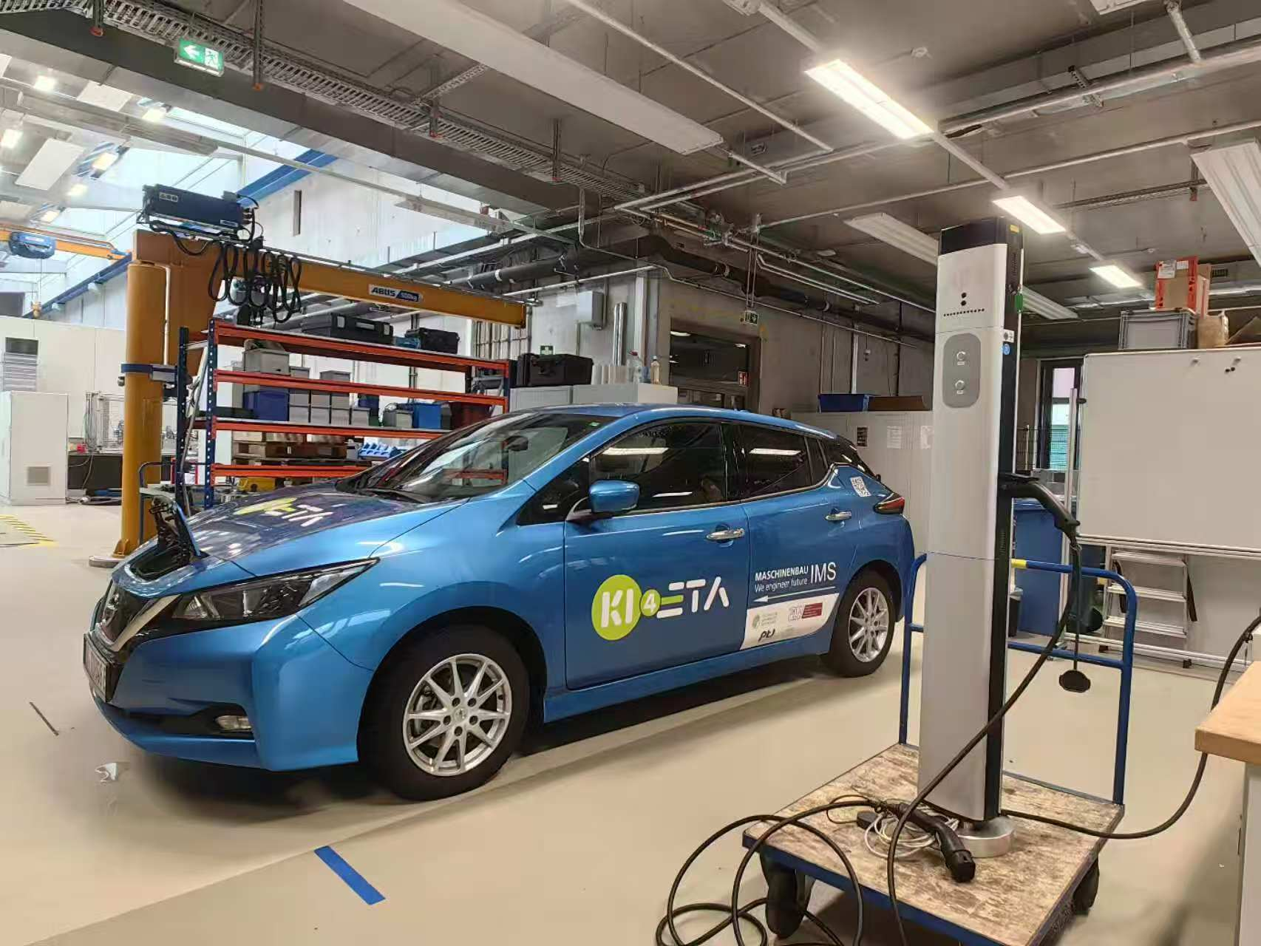
ADP - Charging Station Upgrade to OCPP Communication for Smart Charging
reported by Junfan Jin, Can Zeng, Yunan Jiang and Huang Chen

Slide 2
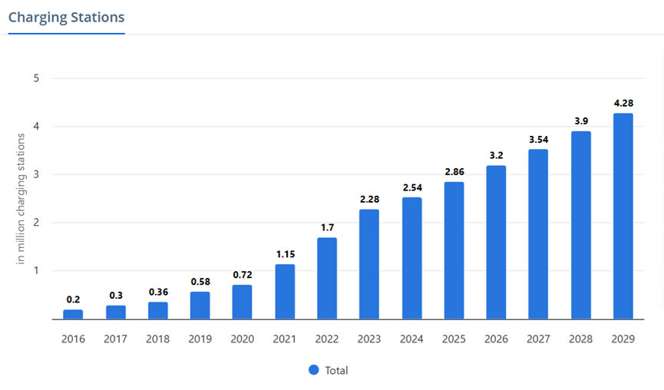
Background
1, Increasing number of
EVs & Charging Stations
2, In Germany, “plug and
charge” mode of 10 million
EVs by 2035 increase 50%
in low-voltage grid and
transformer costs [1]
Figure 1: Charge station sales increasing over the years [2]

Slide 3
Significance
OCPP
Peak shaving
Variable charging rate
Open source
Decrease overload of grid
Electricity price
Battery capacity

Slide 4
Objectives
1, Search and read existing literature on standardized charging infrastructure and smart charging
2, Learn about the existing charge point
3, Upgrade the old charge point
to support the OCPP communication protocol
4, Complete the construction of a prototype of a smart charging system
5, Test and debug the functions of the smart charge point

Slide 5

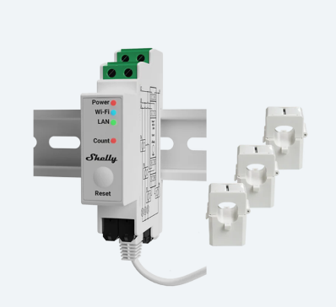
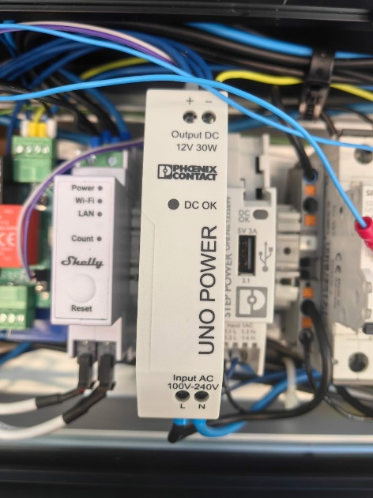
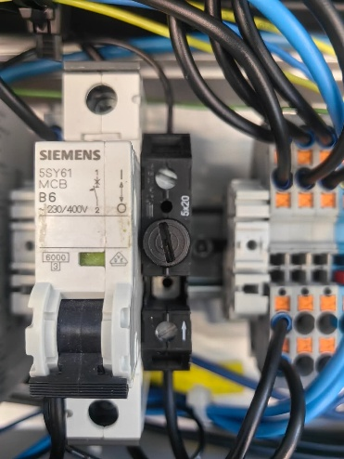
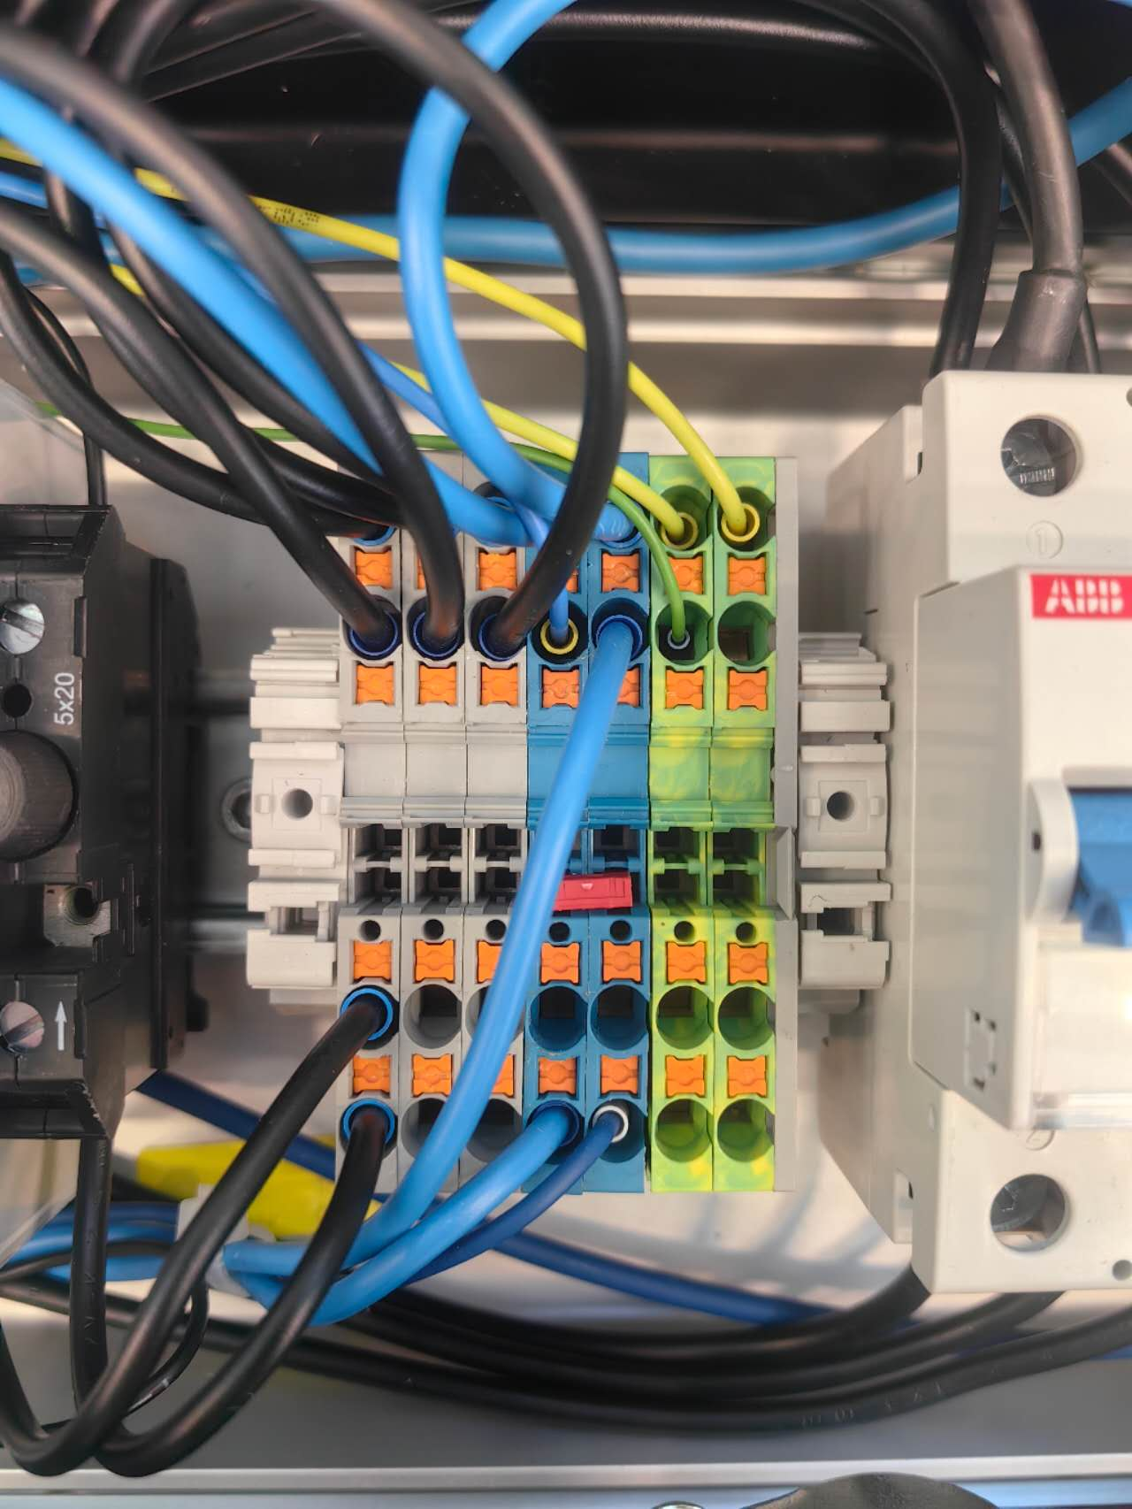
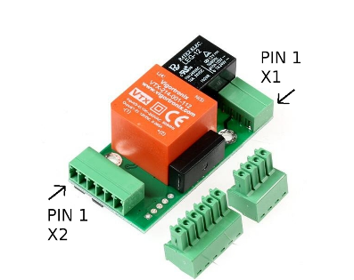
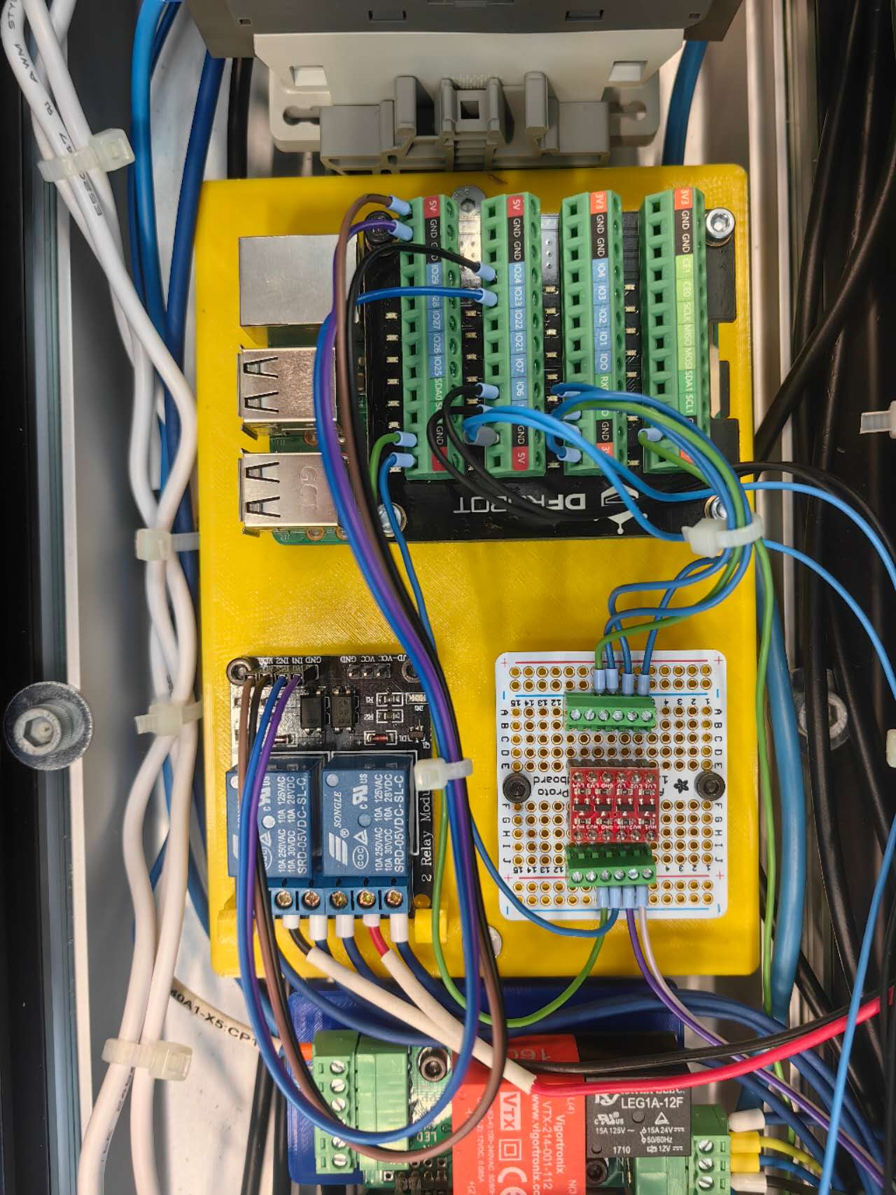
Hardware
Shelly sensor
Power supply, Circuit breaker, Fuse, Wire connector, etc.
EVSE
SmartCharge Board
Auxiliaries
Original charge station
Main functional components
Notes:
Our charging station is mainly composed of these parts

Slide 6
Main functional components
Shelly sensor
Shelly Pro 3EM
3 current clamps measure the 3-phase current: used for Data Visualization.
Record total charged energy: used for the Calibration of the charge plan.
EVSE
Electric Vehicle Supply Equipment
Communicate with EV in the form of PWM signal and voltage level, indicating the maximal allowed current and vehicle state.
Controlled by reading/writing the corresponding registers via Modbus communication
Notes:
The main functional components include a shelly sensor. This sensor can measure the current of each phase of the 3-phase power and provide data for our system.
EVSE stands for Electric Vehicle Supply Equipment. The duty cycle of PWM signal indicates the allowed current. The voltage level describes the vehicle state like whether the EV is ready or is in charging. Through Modbus communication, the system implements different functions by reading and writing different registers of EVSE.

Slide 7

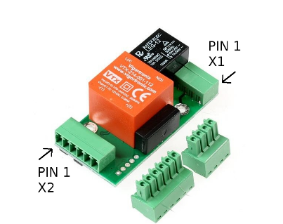
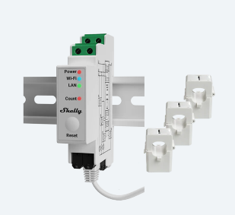
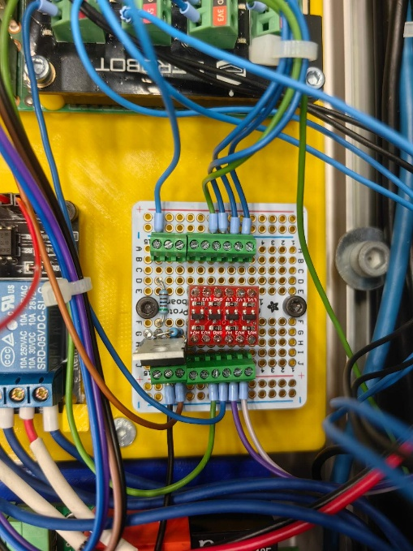
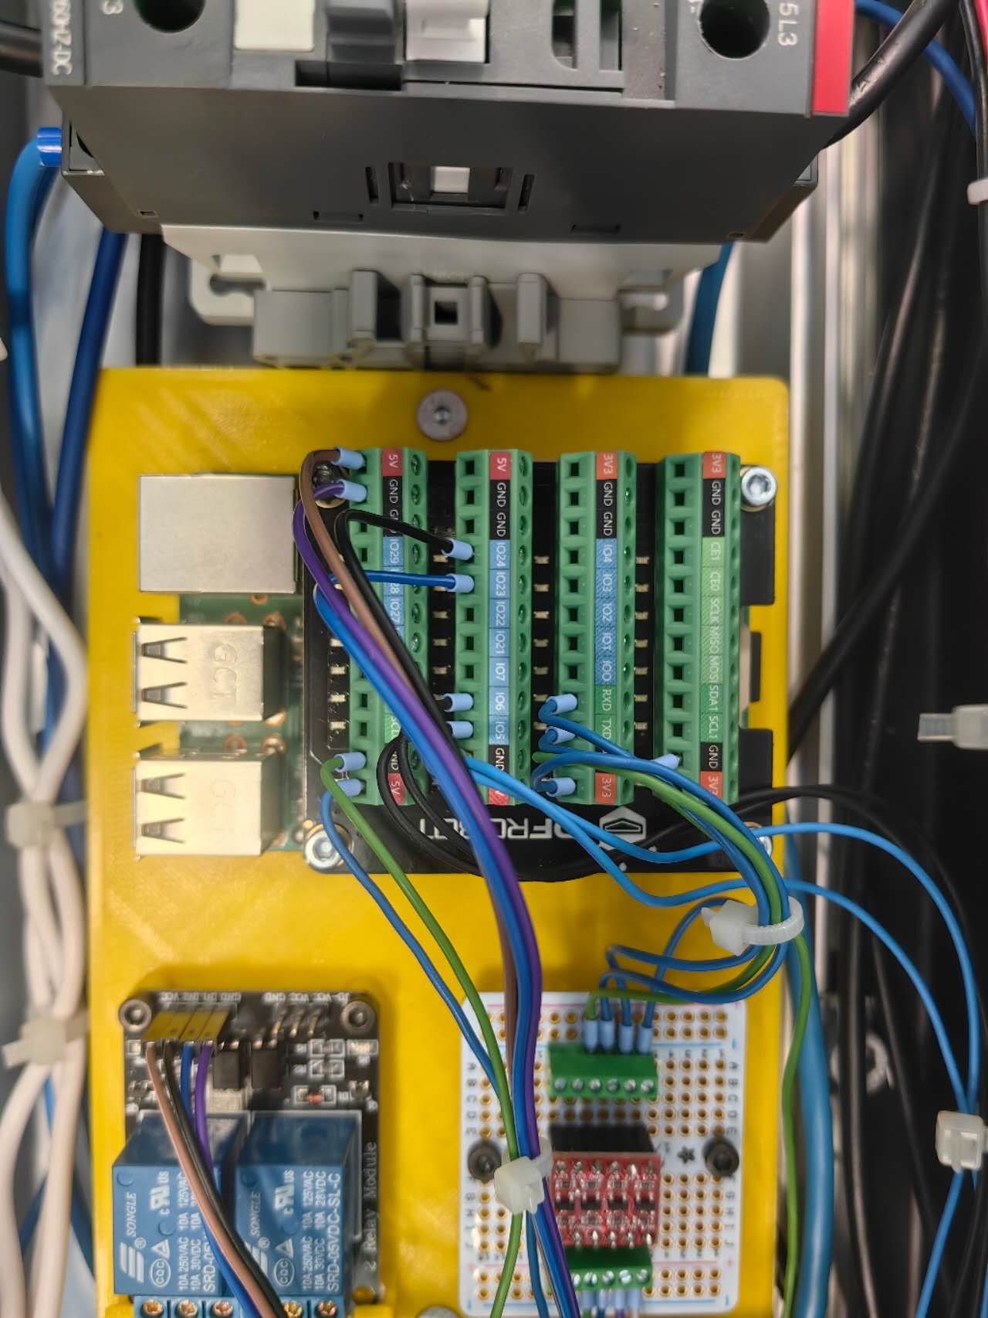

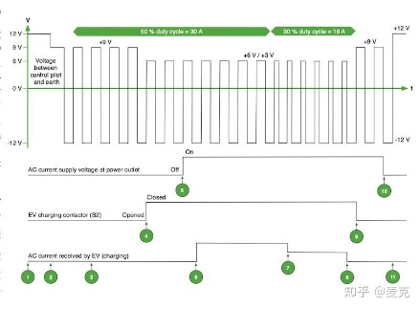

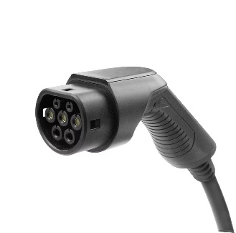
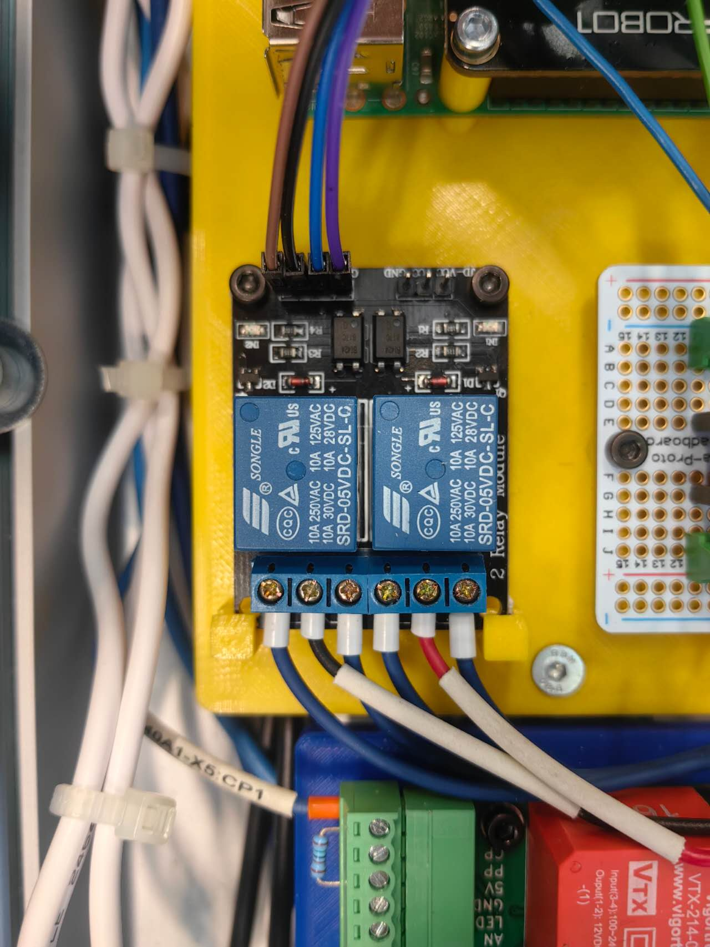
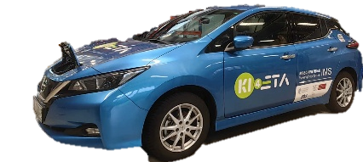
Main functional components
Server
3.5V
Level shifter
5V
EVSE
GPIO
HTTP request
Modbus
Shelly
Raspberry Pi
GPIO
LED
PWM signal
Latch motor
Relay
Notes:
The smart charge board is the most important part. It is a 3D-printed board to mount the Raspberry Pi, level shifter, and a dual channel relay.
Raspberry Pi is the carrier of the program. It is connected to the WiFi, which is provided by the Shelly sensor, and acquires the data with HTTP request.
As mentioned, the Raspberry Pi communicates with EVSE via Modbus communication. It is worth noting that the working voltage of these two parts is different. That is why we need a level-shifter in between. It prevents the Raspberry Pi from GPIO pin damage.
The EVSE communicates with the EV using PWM signal. We also used the GPIO pins of Raspberry Pi to control the latching and releasing of the charge plug by changing the rotary direction of the latch motor with a relay. We also manipulate the blinking of the LED light to indicate the charging state.

Slide 8
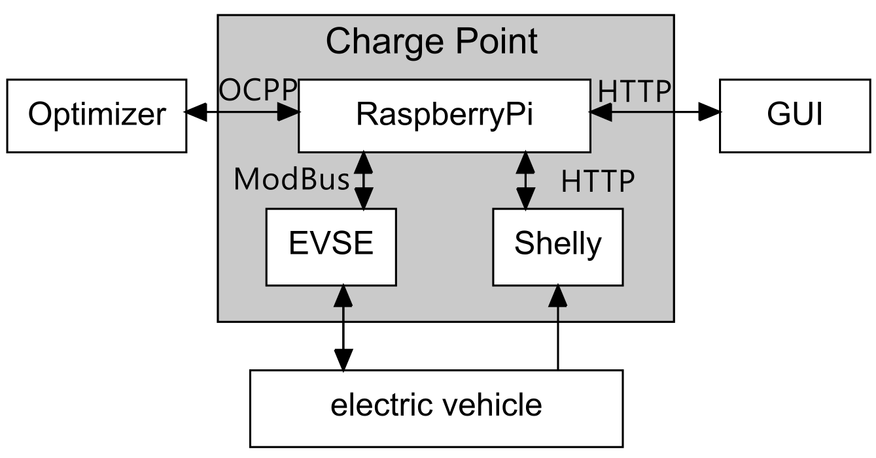
System Architecture - Overview
Notes:
Let’s look at the system structure.
This project has four main parts:
the optimizer, the charging station, the vehicle, and the remote GUI control.
Inside the charging station, we use a Raspberry Pi controller, an EVSE actuator, and a Shelly sensor.
Each part uses different communication protocols:
The optimizer talks to the Raspberry Pi using WebSocket with OCPP.
The GUI and Shellys use HTTP.
The EVSE is controlled by Modbus.

Slide 9



System Architecture - Requirements
Communication Protocol Support
Concurrent Tasks Scheduling
System Expansion Design
Coroutine(C),Multithreading(T)
OCPP Protocol
WebSocket Communication
Coroutine Isolation
C: Message Communication Management
C+T: GUI Remote Interaction Interface
T: Real-time Data Collection and Monitoring
T: Execution of Charging Control Logic
Support for Multi-Port Charging Management
Data Storage and Analysis (Possibility of Providing Database Support)
Notes:
Here are the requirements of our system:
It should support the OCPP protocol, which is based on WebSocket, so we need asynchronous programming.
It should support concurrent task scheduling. The system is complex, with many devices and modules.
One thread is not enough.
So we use both coroutines and threads.
Coroutines can spread through the code if not handled well.
To avoid that, we use coroutine isolation.
This keeps the rest of the system clean.
The tasks are for example: message management, GUI remote control, data collection, and execution of charging logic.
We have also considered system expansion for future needs.

Slide 10


System Architecture - Implementation
Communication
Concurrent Tasks
Expansion
OCPP v2.0.1 Message (JSON)
SetChargingProfileRequest {
"evseId": 1,
"chargingProfile": {
"id": 1,
"stackLevel": 1,
"chargingProfilePurpose": "TxProfile",
"chargingProfileKind": "Absolute",
"chargingSchedule": [{
"id": 1,
"chargingRateUnit": "W",
"chargingSchedulePeriod": [
{ "startPeriod": 0, "limit": 2845 },
{"startPeriod": 10, "limit": 2845 }, …
],
"startSchedule": "2025-04-28T15: 41: 53Z"}, … ],
…
},
"customData": { "vendorId": "001" }
}
Complex hierarchical nesting, difficult to learn structure
Frequent reference to the OCPP Standard is required when writing code
High probability of error, with significant debugging costs
Notes:
OCPP 2.0.1 has many layers and is easy to get wrong.
So we built an OCPP message generator.
It uses Python functions and type hints to help developers create messages step by step.
You can see the structure clearly in the IDE.
This reduces errors and helps the team work faster.

Slide 11

System Architecture - Implementation
Communication
Concurrent Tasks
Expansion
OCPP Message Generator
g = GenSetChargingProfileRequest
OCPP_Message = g.generate(
evse_id = 1,
charging_profile = g.get_charging_profile(*args),
custom_data = g.get_custom_data(*args)
)
Use different generation functions to generate each message part
IDE provides type hints and Docstring
Reduces the learning cost of the OCPP Standard documentation
Structure encapsulation significantly reduces the probability of errors
Unified standard improve team collaboration efficiency

Slide 12
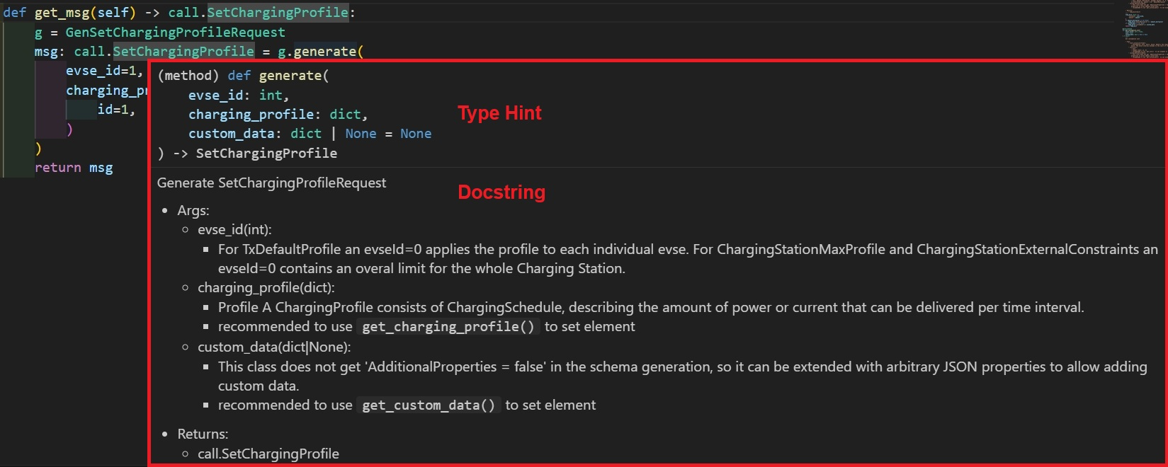
System Architecture - Implementation
Communication
Concurrent Tasks
Expansion
OCPP Message Generator
V2.0.1 —> 128 v1.6 —>78

Slide 13
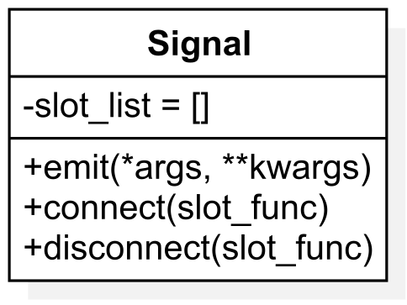


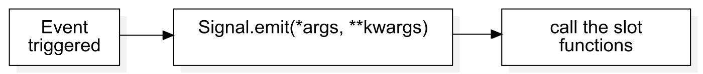
System Architecture - Implementation
Communication
Concurrent Tasks
Expansion
Problem: Multiple modules, complex calls, high coupling
Signal Class -- Decoupling
Supports synchronous/asynchronous calls
No need for fixed callback functions
Facilitates testing, debugging
and expansion
Func
Signal.emit
Func

Slide 14




System Architecture - Implementation
Communication
Concurrent Tasks
Expansion
System Expansion
Database Support: the foundation for data storage and analysis
Support for Multiple Devices (EVSEs, Shellys): Flexible hardware integration
Modular Architecture Design: Easy to combine and expand
Multi-Platform GUI Control Support: Unified Control

Slide 15
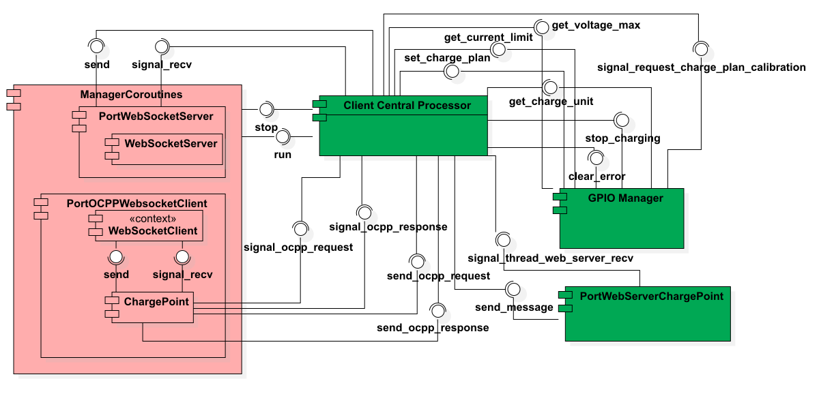
System Architecture – Charge Point

Slide 16
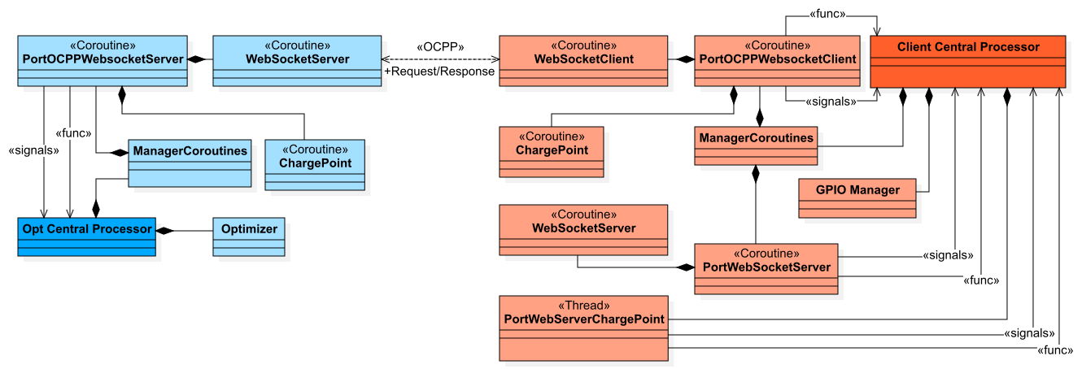
System Architecture - Project

Slide 17



Charge modes
Direct charging
Manual schedule
Dynamic adjustment
Start
Stop
Buttons on the charge pile or website
Charge according to the uploaded schedule
Start time, power
The schedule is generated by the optimizer
Calibration of the charging plan periodically
Notes:
We have designed 3 charge modes.
Direct charging can literally only control the start and stop of charging, by pressing the buttons on the charge pile via the website. Then the charge station will charge at the maximum allowed current.
The Manual schedule mode is mainly used for debugging. The charging station will charge according to an uploaded schedule. The charge time point and charge power are defined in this schedule.
The dynamic adjustment mode is the main target of our project. It realizes the smart charging. The optimizer will generate the charging plan according to the user’s needs like “lowest electric price.” To compensate for the deviation in the charging process, the charge plan will be calibrated based on the data collected from our sensor.

Slide 18
Detailed charging steps
Plug in the charge plug
Select the charge mode and start
Before charging
In charging
Charging ends
EVSE:
EV is present
Check:
Vehicle,
EVSE,
Shelly, applicable plan
Latch plug
Optimizer generates the plan
Max. current to EVSE
Calibration
Polling-EVSE, Shelly
Unlatch
Clear data
If not
ERROR
Hardware failure
Notes:
At different stages of charging, our charging stations will perform different actions.
When the charge plug is inserted, the EVSE will change the value of the register, which indicates the state of the vehicle. Then the user will select the charge mode and press start. The system will check if all the components are working properly, and also check if the plan is applicable, for example, the user wants to fully charge the car in 5 minutes. It is impossible.
If everything is OK, the charge station will lock the charge plug, the Optimizer will generate the plan. The output power is controlled by changing the maximum current of EVSE. The system will periodically calibrate the plan, and get data from the EVSE and the Shelly sensor via polling. If any hardware failure occurred in this process, it will raises an error and the charging will be terminated.
After the charging is finished, the charge station will unlatch the charge plug and clear the data stored in Shelly.

Slide 19
Trim of plan
System response delay
Network delay
Charge
unit 1
1kW
2kW
1kW
2kW
Charge
unit 2
4kW
2kW
delay
4kW
2kW
Charge
unit 3
1kW
2kW
1kW
2kW
Limit
(6kW for example)
8kW
6kW
6kW
6kW
6kW
2kW
1st hour
2nd hour
1st hour
2nd hour
Notes:
In our project, we have considered a lot about the influence of delays. For example, according to the plan, three charge will charge without violating the limit of power. But due to the delay, the charge schedule of unit 2 arrived later than expected. Consequently, the total power exceeds to limitation for the same period of delay. This may cause equipment overload.

Slide 20

Trim of plan
Arrive of New schedule/
Schedule update
Now
New schedule start time is in future
Old schedule
New schedule
Time
Arrive of New schedule/
Schedule update
Now
Old schedule
New schedule after truncation
New schedule
Time
Cut off
New schedule start time already passed
Notes:
To solve this, the system will not directly execute the new schedule.
If the new schedule starts in the future, the system will wait or continue with old schedule.
If the new schedule start time is already passed, the system will cut the expired parts of the schedule, and continue with the rest parts.

Slide 21
Trim of plan
Before truncation
After truncation
Charge
unit 1
1kW
2kW
1kW
2kW
Charge
unit 2
delay
4kW
2kW
4kW
2kW
Charge
unit 3
1kW
2kW
1kW
2kW
Limit
(6kW for example)
8kW
6kW
6kW
6kW
6kW
2kW
2kW
1st hour
2nd hour
1st hour
2nd hour
Notes:
In this way, this problem is avoided and the deviation will be compensated by the following calibrated schedule.

Slide 22
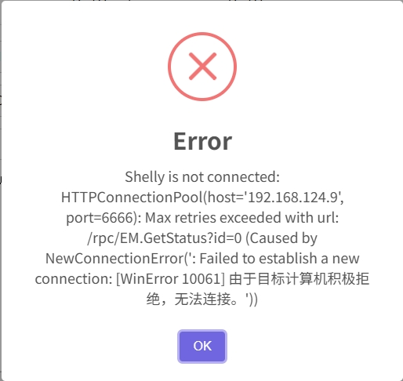
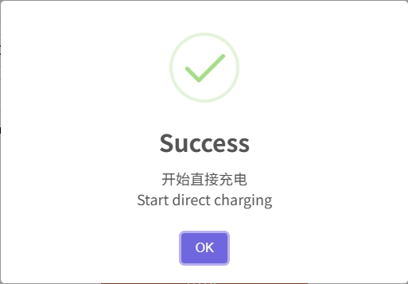
Observe the charging state
按钮图
LED light on the button
pop-up window
Notes:
In order to improve the human-machine interaction experience, apart from the pop-up window on the website, we also utilized the LED light embedded in the button. The blinking frequency of the LED indicates the current charging process.

Slide 23
Optimization method
Why Use scipy.optimize.minimize for Optimization?
Advantages:
Simple algorithm, easy to deploy
High computational efficiency for small-scale problems
No need for large datasets or training
High interpretability, transparent optimization process
Suitable for short-term scheduling or online optimization
Notes:
We ultimately chose to use scipy.optimize.minimize for our optimization task because it’s simple, efficient, and well-suited for small-scale, short-term problems. Unlike deep learning, it doesn’t require large datasets or a training phase, which makes it quick to deploy. Its optimization process is also highly interpretable—we can easily track the objective function values and gradients.
However, there are limitations. When dealing with multiple uncertainties—like price forecasts or user behavior—this method can get stuck in local optima. It also relies heavily on gradient information, which isn’t ideal for non-differentiable or non-smooth functions. Most importantly, it lacks the ability to learn from historical patterns, making it less suitable for long-term predictive optimization where deep learning excels.

Slide 24
Optimization considerations
Predict Charging Demand & Balance Grid Load → Consider with historical data, user patterns, weather, etc. → gene_his_usage() generates realistic usage history
Optimize Charging Costs Under Dynamic Pricing → Adjust charging strategy across time periods → gene_eprices() simulates day/night dynamic pricing
Address Diverse User Preferences → customData.mode supports 3 strategies: • Fast Charge (urgent needs) • Cost-Saving (low-price periods) • Balanced (time, cost, load)
Notes:
In this project, we addressed six major challenges in EV charging optimization.
First, to forecast future charging demand and balance the grid, we use historical usage data and dynamic scheduling algorithms. Our gene_his_usage() function simulates realistic consumption profiles, laying the foundation for intelligent decisions.
Second, for optimizing charging costs under dynamic electricity pricing, we employ predictive models. Our gene_eprices() method simulates price changes between day and night, helping the optimizer adjust for cost efficiency.
Third, we recognize users have different preferences. By extending the OCPP message with a mode field, we support three strategies: fast charging, cost-saving, and balanced.

Slide 25
Optimization considerations
4. Extend Battery Lifespan → Avoid deep discharge, high-rate charging → Intelligent post-full-charge trickle to reduce battery stress
5. Achieve Grid Load Balancing (V2G) → Leverage V2G to feed power back to the grid at peak times → V2G not implemented due to vehicle limitations
6. Improve User Experience → Analyze habits and history to suggest best time & location → Real-time station recommendations, navigation integration
→ Future plan: Develop mobile app for smart personalized charging
Notes:
Fourth, to protect battery health, our strategy includes continuing low-current charging after the battery is full, reducing degradation.
Fifth, although we explored V2G concepts for load balancing, this was not implemented due to vehicle limitations.
Lastly, we aim to enhance user experience through personalization. While this feature is not yet complete, we plan to develop a mobile app that suggests optimal charging locations and times based on user habits and real-time availability.
Together, these strategies form a smart, adaptable EV charging system focused on efficiency, user needs, and grid stability.

Slide 26
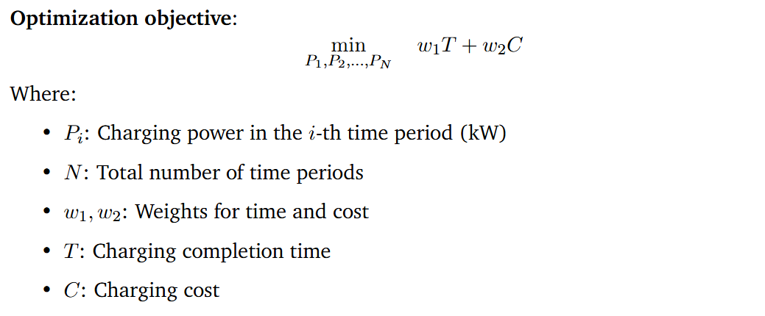
Optimization objective
Notes:
This is the core optimization objective of our charging strategy.
We aim to minimize a weighted sum of two key factors: the charging completion time T and the charging cost C.
The variables we optimize are the charging powers P1,P2,…,PNP_1, P_2, \dots, P_NP1​,P2​,…,PN​ across NNN time periods.
The weights w1w_1w1​ and w2w_2w2​ allow us to adjust the priority between speed and cost— for example, in fast charge mode, we assign a higher weight to time; in cost-saving mode, the cost term becomes more important.
This flexible formulation lets us tailor the strategy based on user preferences or grid conditions.

Slide 27
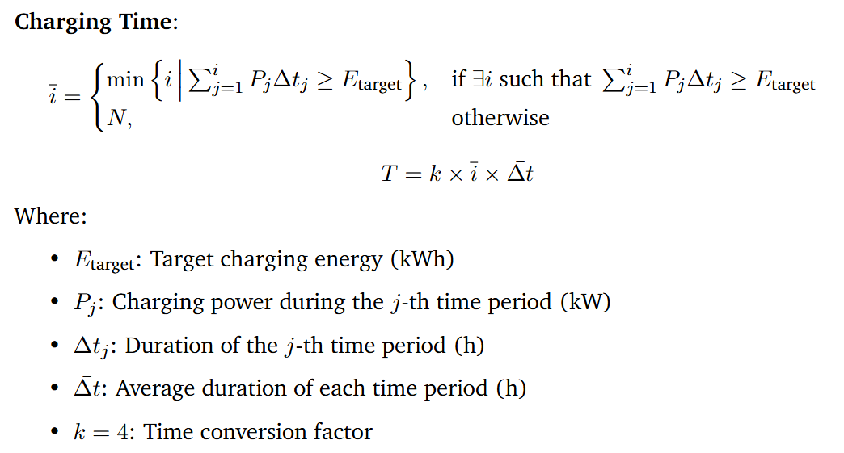
Optimization objective
Notes:
This equation defines how we calculate the charging time required to reach the energy target.
First, we identify the earliest time index i‾\overline{i}i at which the accumulated energy from charging—calculated as the sum of PjΔtjP_j \Delta t_jPj​Δtj​—meets or exceeds the target energy EtargetE_{\text{target}}Etarget​.
If the target is never met, we assume the full schedule is used.
Then, we compute the total charging time Tby multiplying i‾\overline{i}i with the average time step Δtˉ\bar{\Delta t}Δtˉ and a factor k, which adjusts the time units to match our system output—such as converting hours to time slots or cost units.
This approach allows us to evaluate and minimize charging duration as part of the overall optimization.

Slide 28
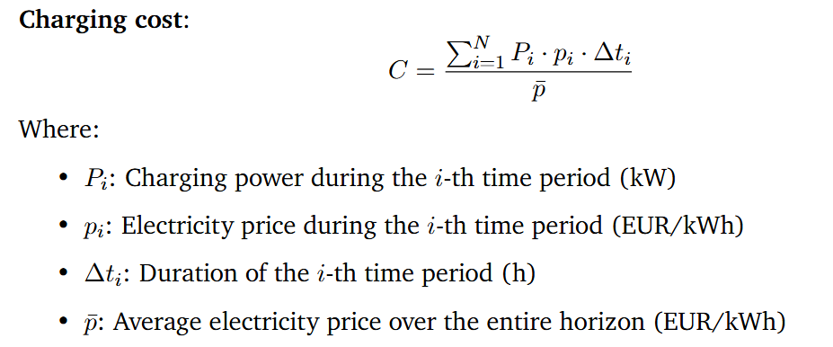
Optimization objective
Notes:
This equation defines the charging cost CCC as a normalized sum of energy consumption over time.
In each time period iii, the cost is calculated as the product of the charging power PiP_iPi​, the electricity price pip_ipi​, and the duration Δti\Delta t_iΔti​.
We then sum this over all time periods and normalize it by the average electricity price pˉ\bar{p}pˉ​.
This normalization allows us to compare cost-effectiveness under different pricing conditions and ensures the cost term is consistent with other terms in the objective function.
By optimizing this term, the system prefers charging during low-price periods while still ensuring the energy demand is met efficiently.

Slide 29


Optimization objective
Notes:
To ensure feasibility and safety, our optimization includes two key constraints.
First, the total charged energy—the sum of Pi⋅ΔtiP_i \cdot \Delta t_iPi​⋅Δti​ over all time periods—must meet or exceed the target energy EtargetE_{\text{target}}Etarget​.
Second, in each time period, the charging power PiP_iPi​ must stay within its allowed range, defined by a minimum and maximum power limit, Pmin⁡,iP_{\min, i}Pmin,i​ and Pmax⁡,iP_{\max, i}Pmax,i​. These bounds can vary depending on hardware limits or grid constraints.
For the initial guess used by the optimizer, we simply set P0P_0P0​ as the average of all maximum powers across the time horizon.
This initialization provides a reasonable starting point for the solver to quickly converge to an efficient solution.

Slide 30
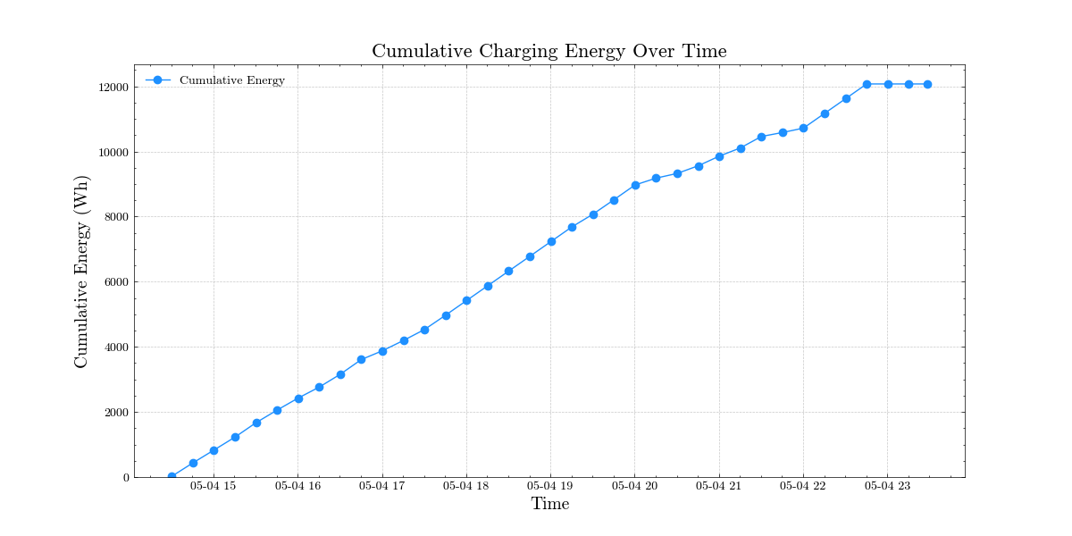
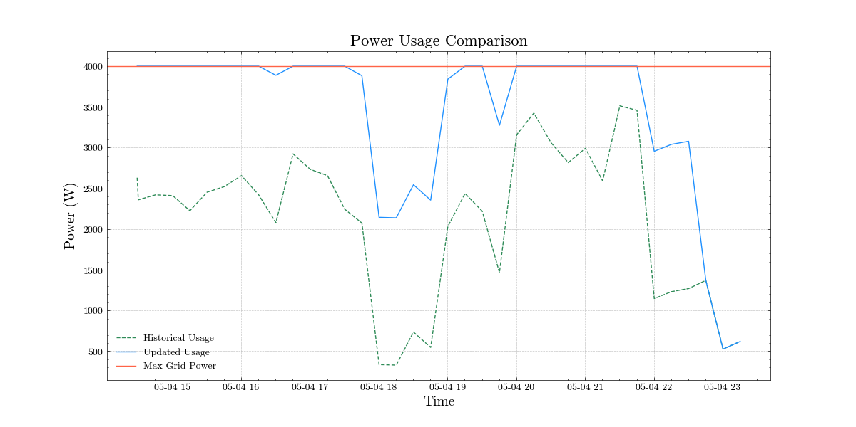
Optimization result

Slide 31
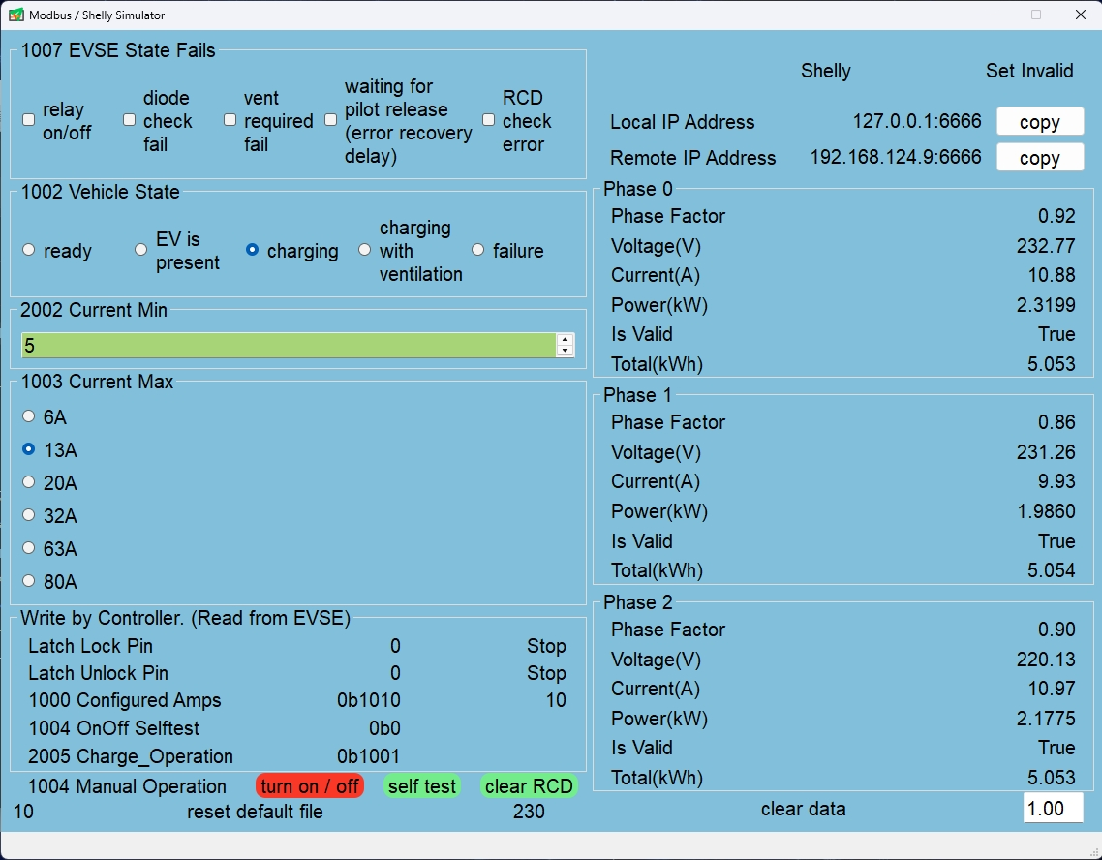
Simulation
EVSE & Shelly Simulator
Notes:
We wrote a software to simulate the reading and writing of evse and shelly, which is convenient for debugging algorithms without hardware.
The simulator is developed using PyQt5 and provides a visual interface, allowing users to view and adjust simulation parameters.
This simulator allows for the debugging and optimization of the system’s charging control logic in a safe testing environment, ensuring functionality correctness and reducing the safety risks associated with direct live testing.

Slide 32

Problems during Testing
1, No indicator for charge point
Solution: LED for the Start button
lit – charge point ready to
set current
blinking – Charging beginns
2, Modbus port allows only one thread at
one time
Solution: first, serialize access using thread
lock (use context manager to
manage)
then ensure globlally unique
access with singelton pattern
3, Register 1006 “only readable”
Figure 2: Test in lab
Figure 3: Register 1006 status of EVSE from datasheet

Slide 33
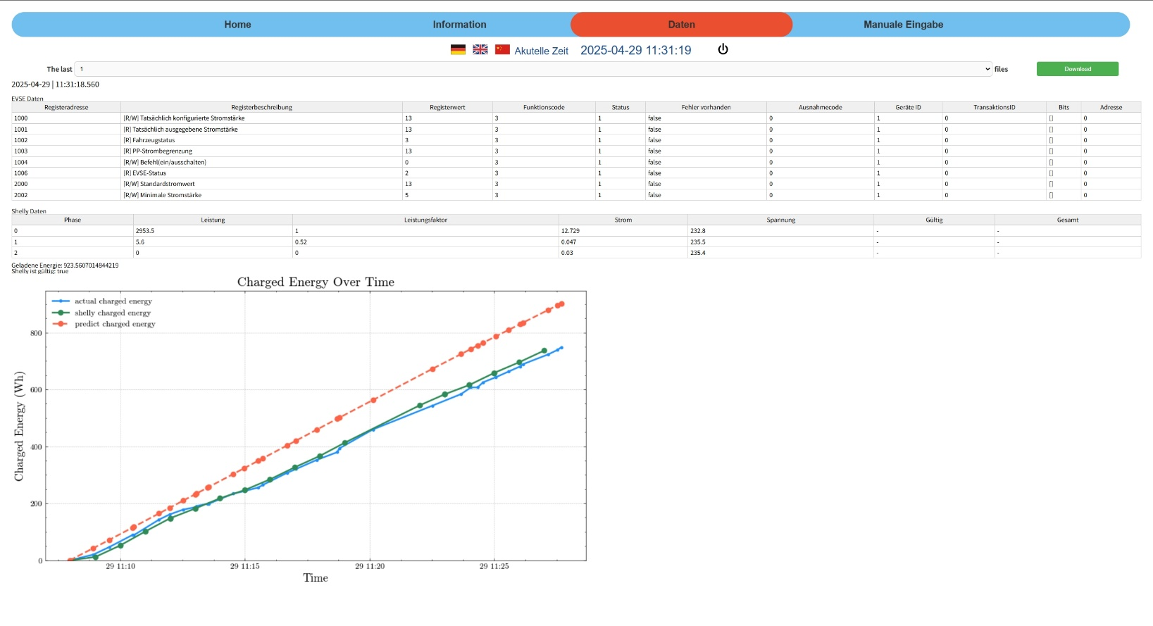
Conclusions
1, Results
1,1 Charging point control and optimization
3 modes: lowest-cost charging, shortest-time charging and dynamical charging
1,2 Data visualization
Figure 4: GUI

Slide 34
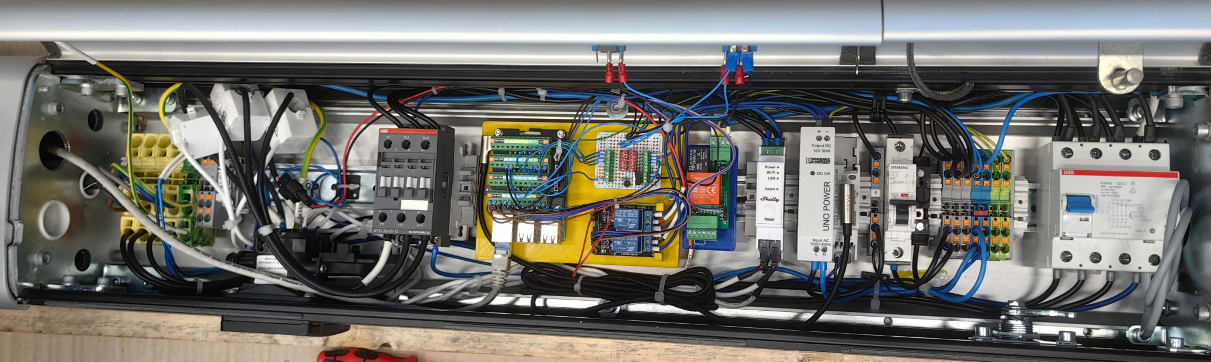
Conclusions
1,3 Communication between charge point and optimizer
1,4 GUI Deign including charging status, log information and control operations
1,5 Simulator Deign
1,6 Hardware modification (Raspberry Pi, Shelly, relay for DC-motor and LED-
indicator)
Figure 5: Hardware connection

Slide 35
Conclusions
2, Discussion
2,1 Compatibility Issues with the OCPP Python Library Versions
2,2 Current Monitoring and Safety Control
2,3 Raspberry Pi Wi-Fi Hotspot Support
2,4 Limitation on Web Terminal Message Display (memory overflow or browser crashes)

Slide 36
Literature
[1] https://www.statista.com/outlook/mmo/electric Electric Vehicles.url:vehicles/worldwide
(visited on 01/2025).
[2] International Renewable Energy Agency(IRENA). Innovation Outlook Smart Charging For Electric Vehicles.Tech. rep. International Renewable Energy Agency(IRENA), 2019

